Slide 1

DIOCESE OF DES MOINES
MEDIA WEBINAR
APRIL | 2020

Slide 2

SESSION GOALS
The goal of this webinar is to increase your knowledge and skills when creating videos using a smartphone.
Wixted & Company will cover the following:
Messaging recommendations
How to produce high quality videos using an iPhone
Answering questions

Slide 3





YOU
BECOMING AUDIENCE-CENTRIC
NET IMPRESSION
MESSAGE
AUDIENCE
BUSINESS GOAL
To inform? To persuade? To motivate?

Slide 4
MESSAGING CONSIDERATIONS
Build Common Ground
  Acknowledge the uncertainty
  Be empathic
  Outline your goal
    Great for interacting directly with followers
    It is Live, no do-overs
Main Message: overarching message 8-10 words
  Support Message 1
  Support Message 2 story | analogy
  Support Message 3
Conclusion
  Thank you
  Common ground
  Call to Action

Slide 5
SHOOTING BASICS
Hold your phone horizontally
  Use the back camera when possible
Keep your phone steady
  Position your phone on a stand or books at eye level
  Conduct the video sitting or standing with someone shooting

Slide 6
SHOOTING BASICS
Have good lighting
  Lamps, desk lamps work great
Clean background
  Plain walls, bookshelves, wall art
  Don’t go too wide—keep it tight but allow for headroom
Speak loudly and clearly to pick up good audio
  Be sure the microphone is unobstructed

Slide 7
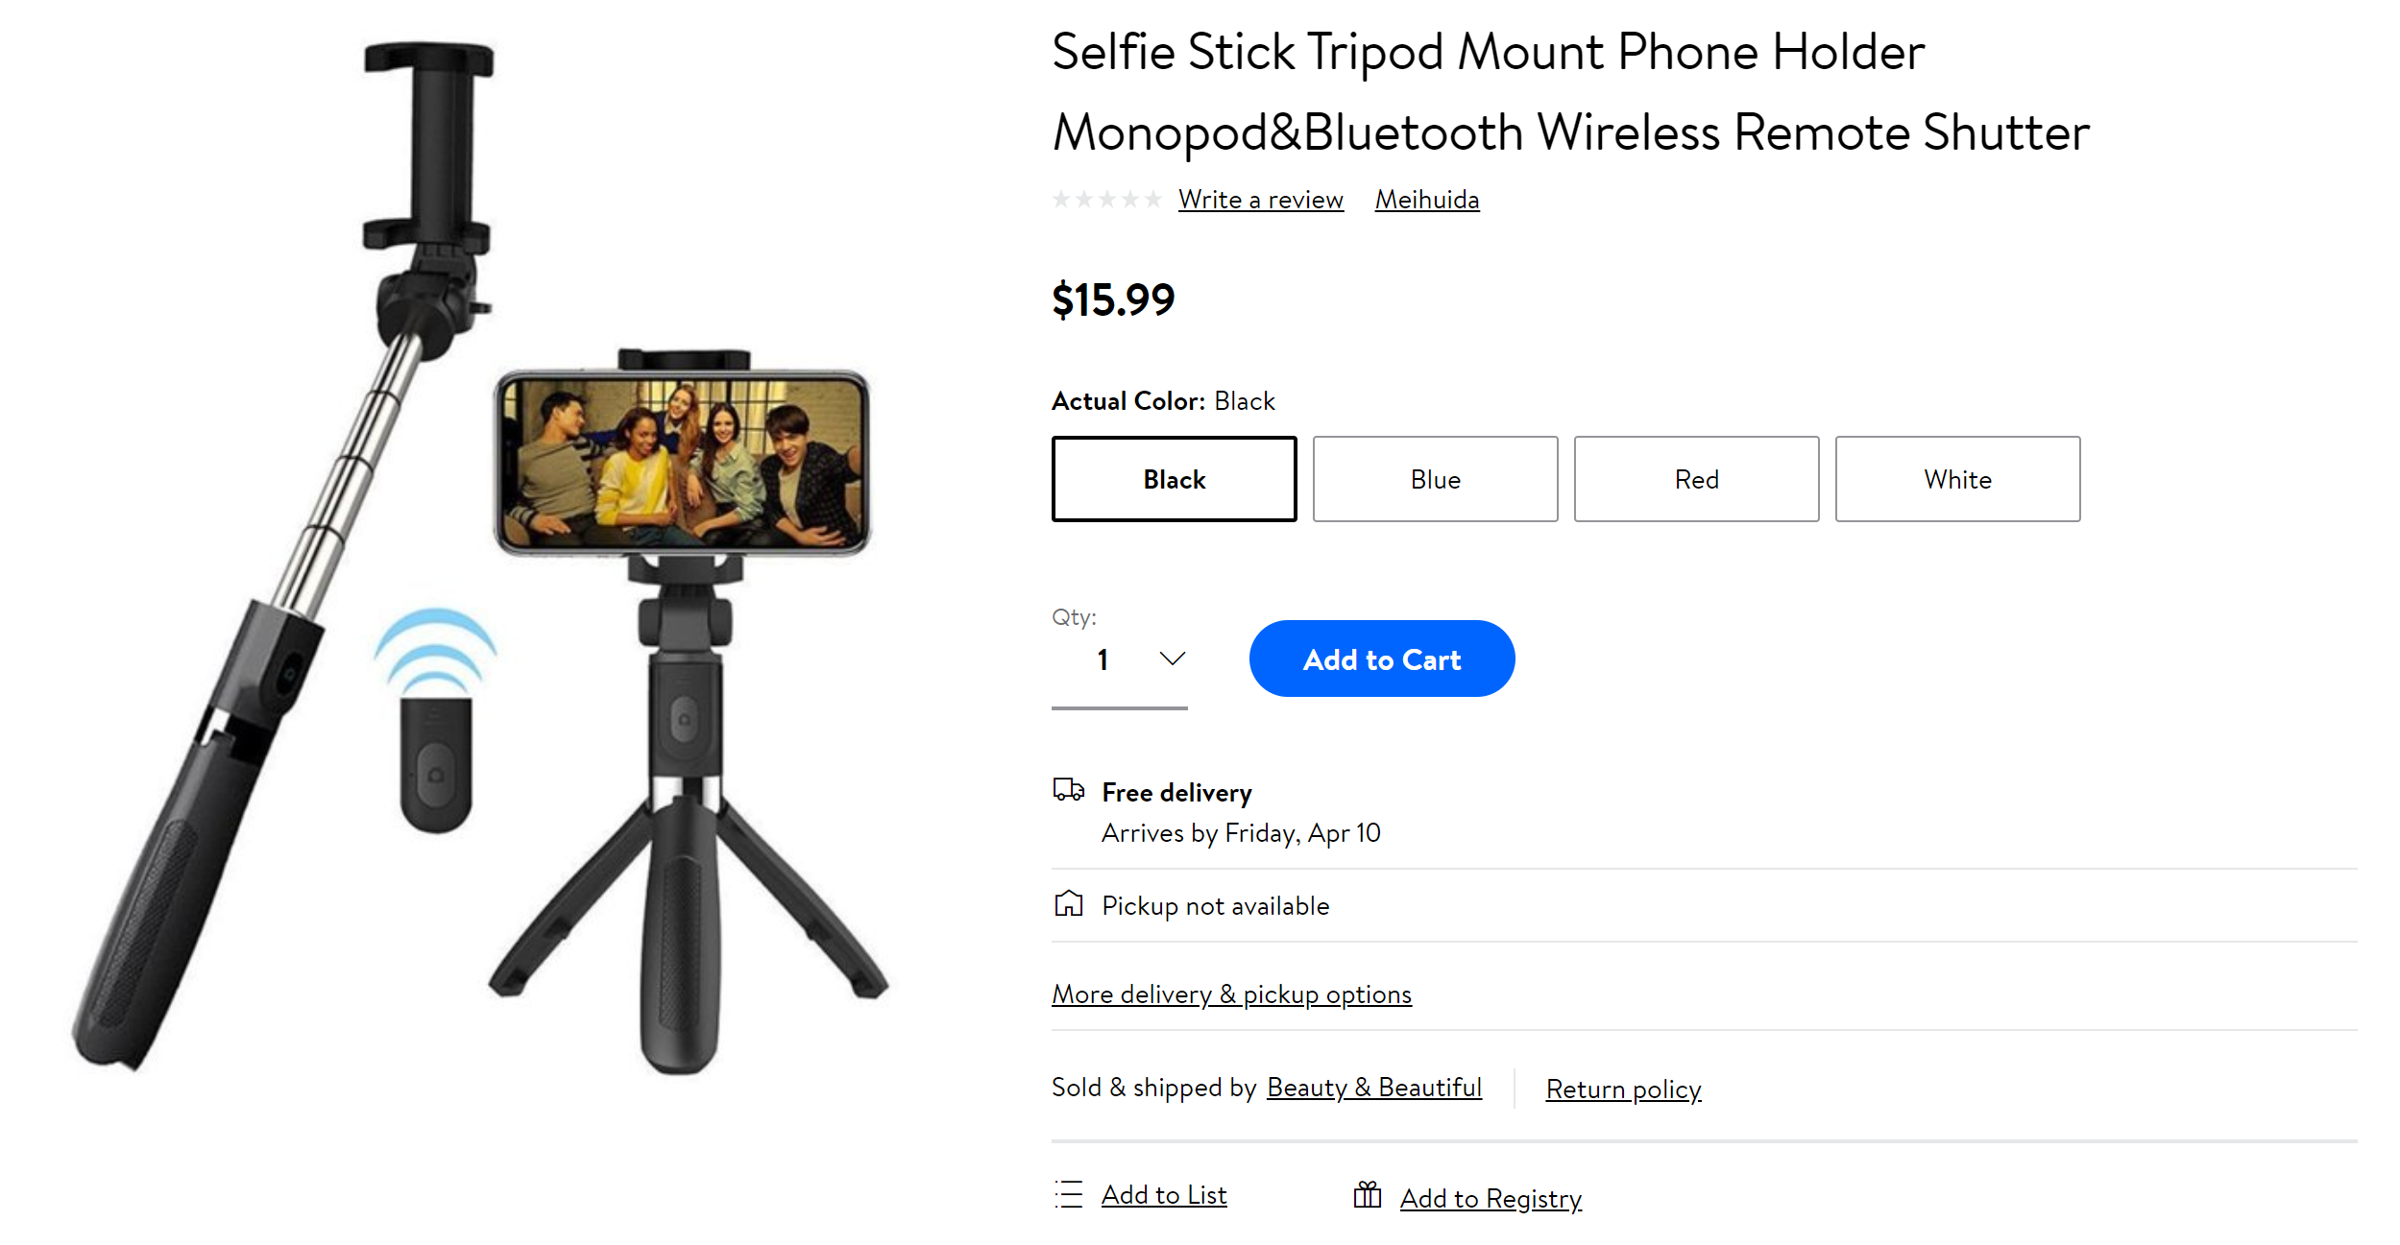
OPTIONAL ACSSESORIES

Slide 8
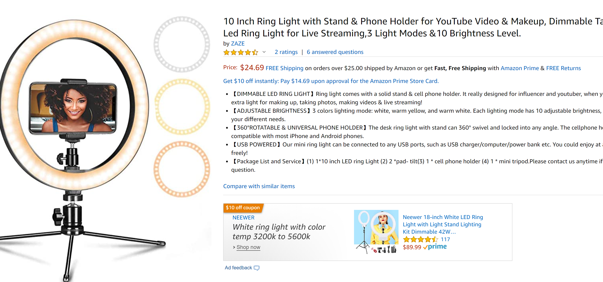
OPTIONAL ACSSESORIES

Slide 9
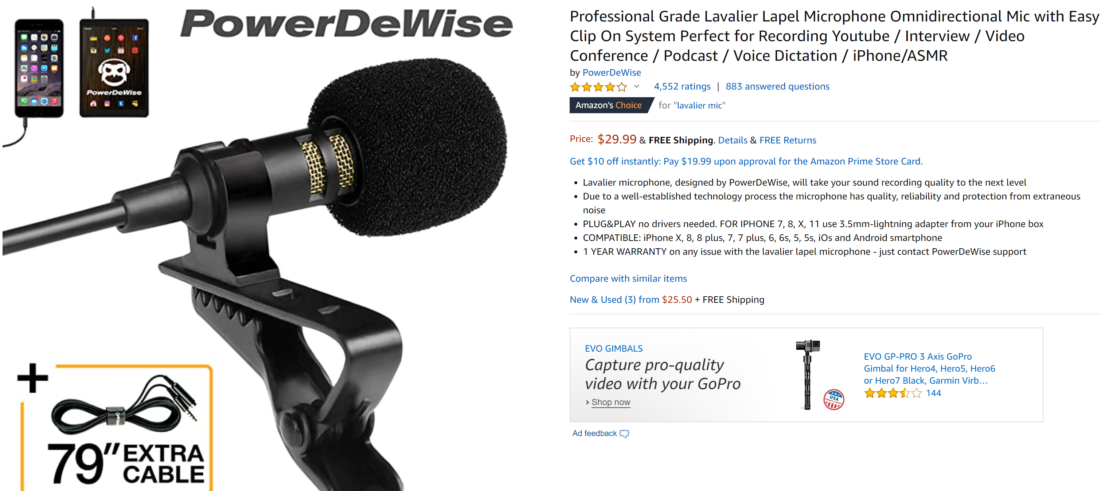
OPTIONAL ACSSESORIES

Slide 10
UPLOADING BASICS
Facebook
  Facebook Live:
    Great for interacting directly with followers
    Better to use front facing camera to avoid glitches
    It is Live, no do-overs
  Facebook Videos:
    Great for delivering polished videos
YouTube
  Another great place to put polished videos
Website
    Use text when sending out videos. It will be easier to locate and get your viewers interested in what you are posting.

Slide 11
Any questions?
Questions
Feel free to email Anthony at:
          acaligiuri@thinkwixted.com

Slide 12


FOLLOW US ON SOCIAL MEDIA
www.thinkwixted.com
www.facebook.com/WixtedCo
www.linkedin.com/company/wixted-&-company

